Slide 1
AB 52 and its Implementation Protecting Tribal Cultural Resources in the CEQA Process
CILA 16th Annual Conference
Viejas Resort & Casino
October 14, 2016
Notes:
Thank you to Board and invitation from the organization to visit you in your homelands to discuss this issue.

Slide 2
Panelists
Michele Hannah
Deputy General Counsel, Pechanga Band of Luiseño
Courtney Coyle
Attorney at Law
Chair, City of San Diego Historical
Resources Board

Slide 3
Summary of AB 52
Passed in 2014; Sponsor: Mike Gatto (D-Glendale)
Amends California Environmental Quality Act (CEQA)
New Class of “Resources” Under CEQA: Tribal Cultural Resources.

Slide 4
Summary of AB 52
A new inclusion of tribes, tribal cultural values, and tribal expertise in cultural & environmental resource protection
Progeny of SB 18 (Tribal Consultation in Planning) and Gubernatorial Order B-10-11 (Encouraging State agency consultation and coordination)

Slide 5
Summary of AB 52
Tribal Cultural Resources
A site feature, place, cultural landscape, sacred place or object, which is of cultural value to a Tribe
AND is either: On or eligible for the CA Historic Register or a local historic register,
OR the lead agency, with evidence & discretion, chooses to treat the resource as significant (See: PRC 21074 (a)(1)(A)-(B))

Slide 6
Summary of AB 52
TCR Identification & Tribal Consultation Now Required Aspect of CEQA Review
Consultation Required when Requested by Tribes (both federal & state recognized)
Meaningful Consultation to Determine Impacts on TCRs and mitigation measures
Consultation must be BEFORE mitigated negative declaration or Draft EIR release.

Slide 7
Summary of AB 52
Consultation ends on agreement or when determination no agreement is reachable.
Guiding Principles for Lead Agencies:
Avoid Impacts on TCRs when possible
Give weight to tribal values & expertise when considering mitigation measures & include measures in environmental documents.
Confidentiality

Slide 8
AB 52 Regulations Finalized
AB 52 Regulations Completed July 1, 2016.
Provide guidance and language for draft checklist
Appendix G (Checklist Form)

Slide 9
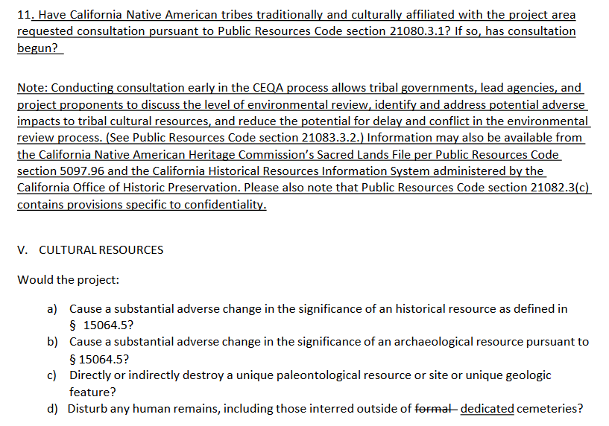

Slide 10
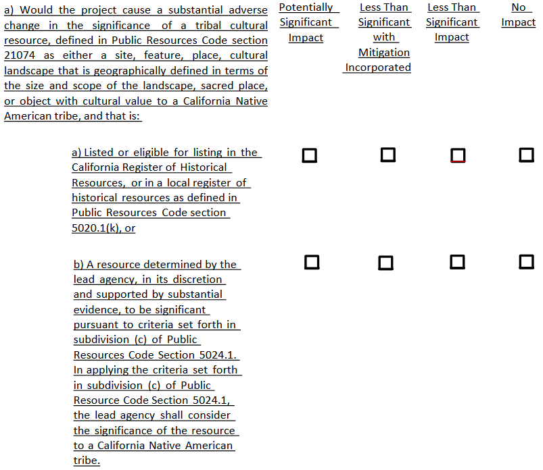
Notes:
Applicability of State Laws
Unless the Congress has waived tribal immunity or granted authority to states over tribes, then state laws do not apply in Indian territory. Williams v. Lee (infringement), McClanahan v. State Tax Commission of Arizona, New Mexico v. Mescalero Apache (preemption), etc.
Off-reservation, the question is slightly different: state laws may apply to off-reservation entities like LCTHC, but the State has no jurisdiction to enforce those laws against tribes. (DLSE Manual says as much).

Slide 11
Regulations
Guidance and Checklist Draft went through several iterations
Non-tribal entities opposed detail in guidance re consultation
OPR rejected tribal proposals to “split out” TCR provisions under its own section.
Final a heading under cultural resources with historical & archaeological resources

Slide 12
Where are we now with AB 52?
Tribes should make standing requests for notification of projects
Agencies should check both NAHC lists AND with their local tribes.
Tribes: List of lead agencies on NAHC website.
Early consultations will likely ferret out process challenge and best practices

Slide 13
Things to Consider
AB 52 Process only triggered when CEQA applies
Categorical Exemptions
Existing facilities; replacement or maintenance; “ministerial” actions; minor alterations or small structures
Relies on Tribal request and later notice
Early conclusion to consultation

Slide 14
Adam P. Bailey
abailey@hobbsstraus.com
Hobbs, Straus, Dean & Walker LLP
Sacramento, CA
916-442-9444

