Slide 1
Advancing water equity in Indian country
Vanessa Racehorse
CALIFORNIA INDIAN LAW ASSOCIATION - April 28, 2022

Slide 2
MY BACKGROUND
Notes:
https://www.cabq.gov/city-photos

Slide 3
WATER EQUITY in Indian country
I.
Easy & reliable access to safe, clean, affordable drinking water
II.
Fair share in economic, social & environmental benefits of clean water & stable water infrastructure
III.
Resiliency in the face of climate change
Settlement of water claims & ability to fully exercise tribal water rights
Further development & application of federal and/or tribal laws & regulations to safeguard & ensure high quality water.
Strategically increasing water efficiency, water recycling, and adequate development/repair of rural water projects.

Slide 4
tribal RESERVED water rights – The cases
United States v. Winans (1905)
Winters v. United States (1908)
Arizona v. California (1963)
Held that the water rights were effectively reserved at the time of creation of the reservations.
Reserved rights doctrine: Any rights that are not specifically addressed in a treaty are reserved to the tribe.
Tribes entitled to enough water to irrigate all the practicably irrigable acreage on the reservations.
Forms the foundation of Indian water rights.
Only reserves water to the extent necessary to accomplish the purpose of the reservation, and it only reserves water if it is appurtenant to the withdrawn land
When the federal government reserved lands for an Indian reservation, the federal government also implicitly reserved sufficient water to support the purposes of the reservation.
Notes:
United States v. Winans, 198 U.S. 371 (1905); Winters v. United States, 207 U.S. 564 (1908); Arizona v. California, 373 U.S. 546 (1963).

Slide 5
The Lifeblood of the reservation
“It is impossible to believe that when Congress created the great Colorado River Indian Reservation and when the Executive Department of this Nation created the other reservations they were unaware that most of the lands were of the desert kind—hot, scorching sands—and that water from the river would be essential to the life of the Indian people and to the animals they hunted and the crops they raised.”
Arizona v. California, 373 U.S. 546 (1963).

Slide 6
The federal trust responsibility & protecting tribal reserved water rights
Federal government has long promised to tribes permanent homelands, livable reservations, and homes conducive to the health & prosperity of Native peoples.
But for most of the 20th century, Indian water rights were largely left undeveloped & unprotected by the federal government.
Instead, federal policy & expenditures supported development of water infrastructure to benefit non-Indian communities, often at the expense of tribal water rights.

Slide 7
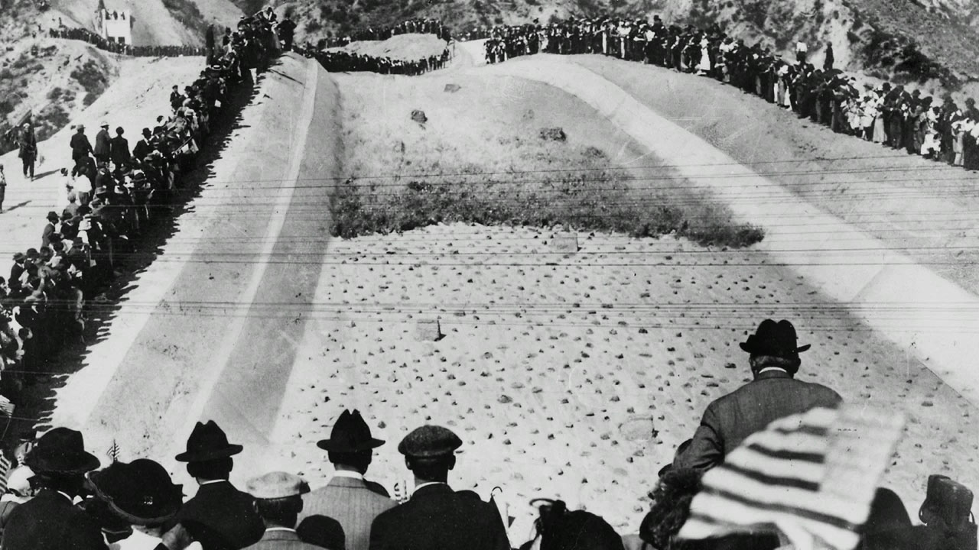
“THERE IT IS. TAKE IT.”
“In the history of the United States Government’s treatment of Indian tribes, its failure to protect Indian water rights for use on the Reservations it set aside for them is one of the sorrier chapters.”
- National Water Commission (1973)
A crowd of 30,000 watched the first water cascade through the aqueduct in the San Fernando Valley. | Los Angeles Department of Water and Power
Notes:
National Water Commission, Water Policies for the Future: Final Report to the President and to the Congress of the United States 475 (1973)

Slide 8
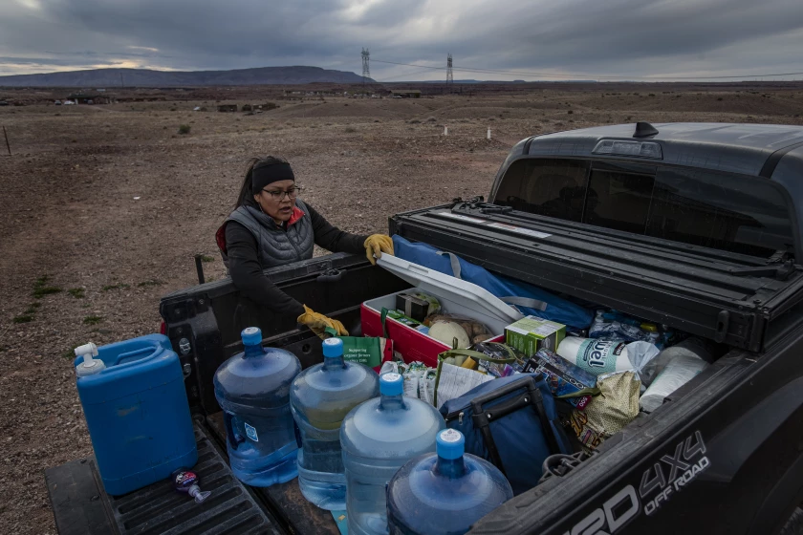
The “water access gap” IN INDIAN COUNTRY
Native American households are 19 times more likely than white households to lack indoor plumbing.
IHS estimates there is a backlog of over 1,500 needed sanitation facilities construction projects & estimates it would take about $3.1 billion to provide all American Indians & Alaska Natives with safe drinking water & adequate sewage systems.
Navajo member Shanna Yazzie unpacks water and other supplies on her reservation in Cameron, Ariz., during the early part of the pandemic in March 2020.(Gina Ferazzi / Los Angeles Times)
Notes:
Closing the Water Access Gap in the United States: A National Action Plan; Indian Health Service, Fact Sheet, Safe Water and Waste Disposal Facilities (May 2021), available at https://www.ihs.gov/sites/newsroom/themes/responsive2017/display_objects/documents/factsheets/SafeWaterandWasteDisposalFacilities.pdf.

Slide 9
THE IMPACTS
Inadequate access to pure water is a major cause of the high rate of mortality suffered by Native Americans.
Lack of clean water and basic sanitation infrastructure either causes illness itself or contributes to the spread of illness.
Insufficient water infrastructure not only facilitates the spread of disease, but also impedes economic development and causes school closures on reservations.
Water infrastructure & sanitation facilities are an essential element of thriving businesses and a healthy workforce.
Notes:
Democratic Staff of the House Comm. On Nat. Res., Water Delayed is Water Denied: How Congress has Blocked access to Water for Native Families 8 (Oct. 10, 2016), http://blackfeetnation.com/wp-content/uploads/2016/10/House-NRC-Water-Report-Minority-10-10-16.pdf.

Slide 10
(SOME) History of infrastructure legislation
Starting in 1867 and through the early 1900’s, Congress began authorizing funding for construction of Indian irrigation projects
1959 - Indian Sanitation Facilities Construction Act, Public Law 86-121
1987 - Clean Water Act - State Revolving Fund
2014 - Water Infrastructure Finance and Innovation Act
2016 - Water Infrastructure Improvements for the Nation Act
2018 – America’s Water Infrastructure Act
2021 - American Rescue Plan and Infrastructure Law
Notes:
For a study of the positive health impacts of investment in sanitation infrastructure in Indian Country, please see Tara Watson, Public health investments and the infant mortality gap: Evidence from federal sanitation interventions on U.S. Indian reservations, 90 J. Pub. Econ. 1537 (2006).

Slide 11
HISTORICALLY INADEQUATE FUNDING
FY2012 - tribes received $0.75 per every $100 of need under the Drinking Water State Revolving Fund.
2009 - federal government spent over $3 billion on water projects in foreign countries and less than 1% of that amount, around $2.29 million, to support tribal access to safe drinking water across all five agencies in 2006.
Yet every dollar spent on sanitation facilities in Indian homes produces over a twentyfold return in health benefits achieved.
Notes:
U.S. Commission on Civil Rights. Broken Promises: Continuing Federal Funding Shortfall for Native Americans (December 2018) Available at https://www.usccr.gov/pubs/2018/12-20-Broken-Promises.pdf.

Slide 12
Funding sources – FOR FUTURE REFERENCE
Indian Health Service - Sanitation Facilities Construction Program
U.S. Environmental Protection Agency
Drinking Water Infrastructure Grants - Tribal Set Aside
Clean Water Act - Tribal Set Aside
Water Infrastructure Improvements for the Nation Act (WIIN) Grant Programs.
Public Water System Supervision Tribal Support Grants
Underground Injection Control Tribal Assistance Grants
U.S. Department of Agriculture’s Rural Development program
U.S. Bureau of Reclamation
U.S. Department of Housing and Urban Development
U.S. Department of the Interior

Slide 13
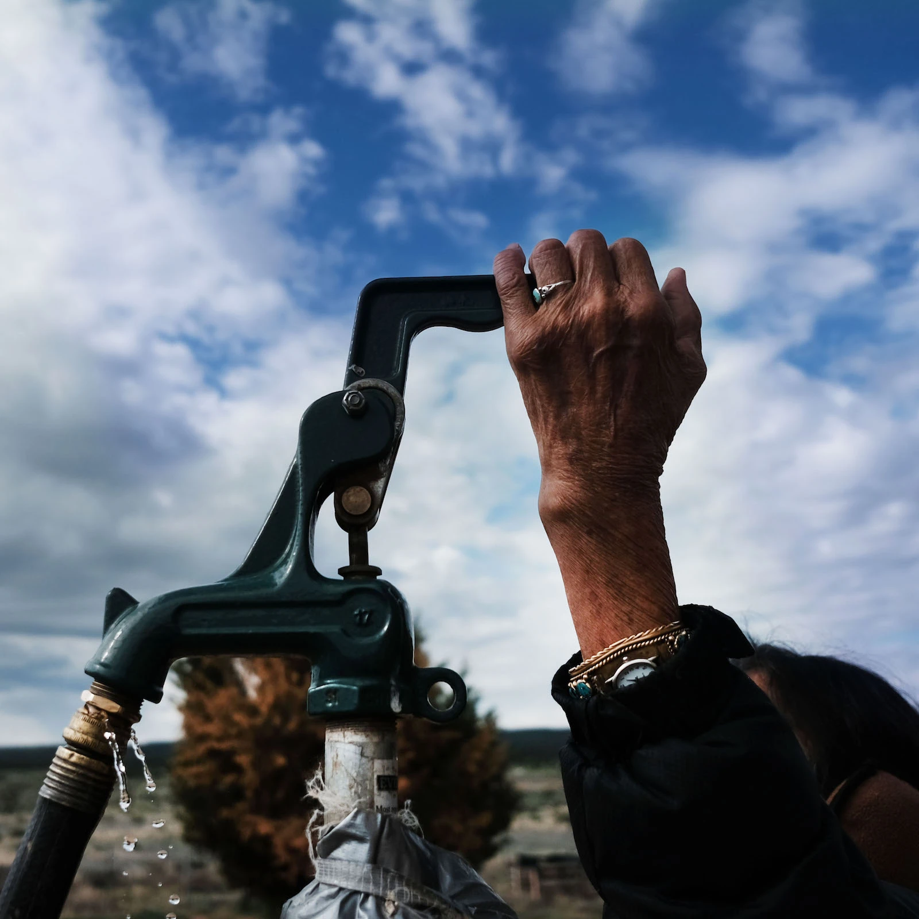
INFRASTRUCTURE INVESTMENT AND JOBS ACT
Largest investment in clean drinking water & wastewater infrastructure in US history
Invests more than $13 billion into tribal communities and makes tribes eligible for billions in investments.
$2.5 billion to implement the Indian Water Rights Settlement Completion Fund
$466 million to BIA for infrastructure projects and climate resiliency initiatives.
Spencer Platt/Getty Images
Notes:
U.S. Dep’t of Interior, Dear Tribal Leader Letter (Dec. 20, 2021), available at https://www.doi.gov/sites/doi.gov/files/esb46-04970-bipartisan-infrastructure-law-consultation-for-tribal-leaders-12-20-2021.pdf; Press Release, Interior Department to Host Tribal Consultations on Bipartisan Infrastructure Law (Dec. 21, 2021), available at https://www.doi.gov/pressreleases/interior-department-host-tribal-consultations-bipartisan-infrastructure-law

Slide 14
Other examples - pROPOSED LEGISLATION
S. 2369 - Tribal Access to Clean Water Act
S. 421 - Western Tribal Water Infrastructure Act of 2021
S. 3308 – Colorado River Indian Tribes Water Resiliency Act of 2021
Authorizes CRIT to transfer water off-reservation for water storage, habitat restoration and to communities impacted by drought.
S. 3168 – A bill to amend the White Mountain Apache Tribe Water Rights Quantification Act of 2010
Extends deadline to complete White Mountain Apache Rural Water System and Miner Flat Dam Project

Slide 15
Clean water act, safe drinking water act & EPA’S ROLE
Congress amended the Federal Water Pollution Control Act of 1948 to become the law now known as the Clean Water Act in 1972.
Congress also passed the Safe Drinking Water Act in 1974, among a series of other environmental laws, to counteract the very clear impacts of pollution that the country was seeing.
U.S. Environmental Protection Agency, through its Office of Water, is responsible for rulemaking efforts & directly implementing Clean Water Act & Safe Drinking Water act programs in Indian Country where tribes don’t have delegated authority.
Notes:
Strengthening the Nation-to-Nation Relationship with Tribes to Secure a Sustainable Water Future, EPA Office of Water Action Plan (Oct. 2021).

Slide 16
TREATMENT AS A STATE (“tas”) authority
Section 518 of the Clean Water Act authorizes EPA to treat eligible Indian tribes with reservations in a similar manner to states
40 C.F.R. § 131.8 sets the eligibility criteria:
(1) the tribe is federally-recognized;
(2) the tribe has a governing body carrying out substantial governmental duties & powers;
(3) water quality standards program pertains to water resources within the tribe’s reservation; and
(4) the tribe is capable of carrying out the functions of an effective water quality standards program.

Slide 17
EXAMPLES - Water quality cases
Hopi Tribe v. United States (2015)
Hopi Tribe attempted to argue that the US must provide the tribe w/ safe water pursuant to the trust relationship but the federal appellate court rejected the claim because no statute explicitly obligated the United States to provide the Tribe w/ safe water.
Agua Caliente Band of Cahuilla Indians v. Coachella Valley Water Dist. (2020)
District Court found that there was not enough evidence presented to show that the change in the water would preclude the Tribe from being able to use its reserved water rights for the reservation’s purpose.
City of Albuquerque v. Browner (1996)
Tenth Circuit found that the EPA’s interpretation that tribes can establish water quality standards that are more stringent than those imposed by the federal gov’t was permissible because it’s in accord with powers inherent in Indian tribal sovereignty.
Notes:
Hopi Tribe v. United States, 782 F.3d 662, 665 (Fed. Cir. 2015); City of Albuquerque v. Browner, 97 F.3d 415 (10th Cir. 1996).

Slide 18
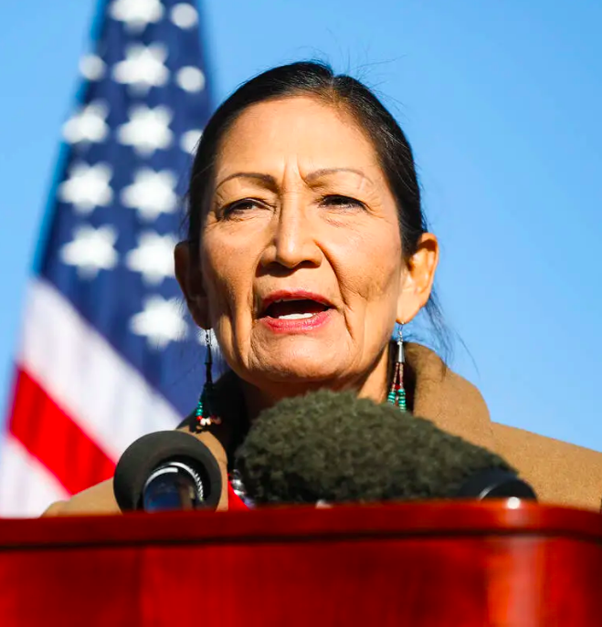
Morton moratorium on tribal water codes
1975 - Secretary of the Interior Rogers Morton issued a Moratorium on approval of tribal water ordinances, codes or resolutions that would regulate the use of water on Indian reservations.
April 7, 2022, Secretary Haaland reversed this memorandum, making it easier for the DOI to review and approve tribal water codes.

Slide 19
Tribal water codes
Water Codes can help tribal governments regulate water usage & other activities impacting water resources
Potential Elements of Tribal Water Codes
Statement of Tribe’s Ownership of Water Rights
Tribal Water Permits, Licenses, Restrictions
Consumptive Uses
Cultural Uses
Administration & Enforcement Provisions
Water Quality Standards

Slide 20
Examples of tribal water codes
Navajo Nation Water Code
Shoshone-Bannock Tribal Water Resource Code
Crow Tribal Water Code
Standing Rock Tribal Water Code
Tribal Water Code of the Seminole Tribe of Florida
Water Quality Standards of the Colville Law and Order Code
Pueblo of Isleta Water Quality Standards

Slide 21
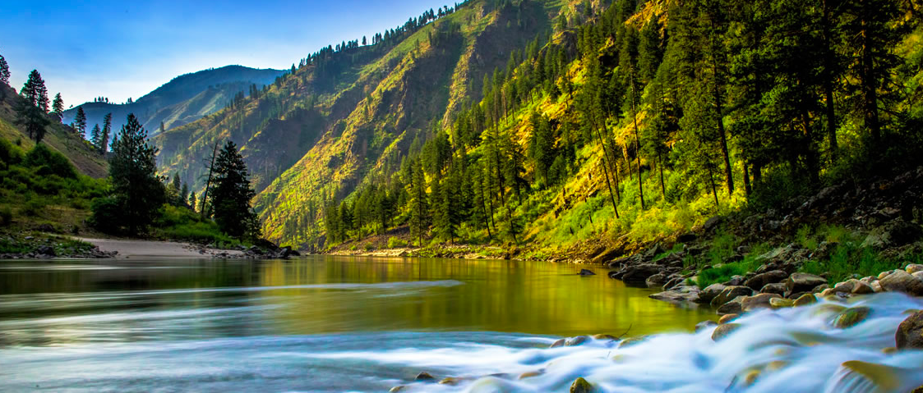
THANK YOU!
Questions?
Your thoughts on how we strategically advance water equity in Indian Country moving forward?

